Slide 1


Slide 2
Schedule
Introduction from Harley Street BID – Nigel Thorne
Legal considerations (Davies and Partners) - Alex Tomlinson
Planning and Sustainable City Charter (WCC) - Isobel Canton, Paolo Balice & Eleanor Grace
UoW and wider sustainability - Morgan Lirette & Virginia Cheung
Networking and refreshments

Slide 3

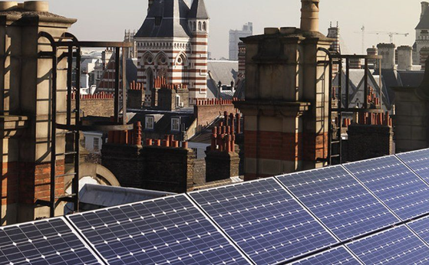

Sustainable Business Practice - Legal Considerations

Slide 4

3 Key Legal Considerations
Engaging with landlords etc.
Minimum Energy Efficiency standards (MEES)
Green Leases

Slide 5
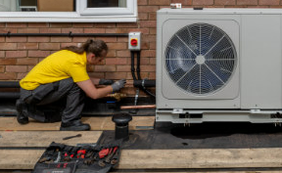
Engaging with:
1. Landlords
2. Lenders
3. Insurance company
4. Planning Authority/LBC
Leasehold - Check your lease
  What is the extent of your premises? Does it include the roof, or that cupboard in the hall?
  What alterations are necessary for your proposed works?
  Is landlord consent required?
  What steps are required to obtain your landlord’s consent?
Freehold - Check with your mortgage company
Insurance company – Check any conditions
Planning & LBC – Is consent necessary?

Slide 6

Minimum Energy Efficiency Standards (MEES)
  1 April 2023 – A Landlord must not grant, or continue to grant a lease of a substandard commercial property.
  Substandard – F&G (for now)…The future trajectory for non- domestic MEES will be EPC B by 1 April 2030.
  Listed buildings – Common misconception that such buildings do not require EPCs. They may...

Slide 7

Green Leases
What are Green Leases?
Why does it matter?

Slide 8

Any Questions?

Slide 9
Introduction to Sustainability and Planning
Our role/function

Slide 10
Session Structure and Objectives
Westminster Planning Team Update
  Overview of the Town Planning Department and Specialist Sustainability expertise
  National and Westminster Policies promoting retrofitting
  Activities and Initiatives in support of Energy Efficiency
Community Engagement
  Questions/Concerns that will feed and shape a planning focus workshop

Slide 11
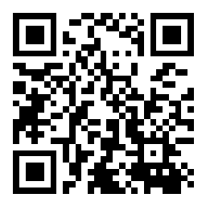
Interactive Session
What is Slido?
  An interactive platform for real-time audience engagement.
  Use it to submit questions during this event.
How to Join:
  Open your web browser on your smartphone, tablet, or laptop.
  Go to www.sli.do and enter the code 3865521 OR
  Scan the QR code on this slide
Participate in Q&A:
  Once you are in, you can start submitting your questions.
  You can also upvote questions asked by others that you find interesting.
  Feel free to ask questions at any point during the presentation.
Anonymous Participation:
  Your questions can be submitted anonymously.
  We encourage open and honest questions to enrich our discussion and workshops.

Slide 12
Director of Place Shaping &
Town Planning
Deirdra Armsby
Head of Design Conservation & Sustainability
Tom Burke
Area Team Leader
North Planning Team
Amanda Coulson
Area Team Leader
South Planning Team
Vincent Nally
Area Team Leader
Central Planning Team
Steve Brandon
Place Shaping and Town Planning Structure (January 2024)
www.sli.do 3865521
The UK planning system regulates the development and use of land to balance economic growth with environmental and social welfare.
It operates through a plan-led approach, where local plans set out policies and guidelines for development in each area.
Planning permission is required for most new developments, changes to existing buildings, or changes in land use.

Slide 13
Head of Conservation, Design and Sustainability
Tom Burke
Senior Conservation/ Design and Sustainability Officer
Eleanor Grace
Lead Retrofit Innovation and Delivery Officer
Lauren Shevills
Principal Sustainability Officer
Paolo Balice
Principal Sustainability Officer
Hrabrina Nikolova
Design /Conservation and Sustainability Team Sustainability Focus (January 2024)
www.sli.do 3865521
A listed building is one that has been placed on the Statutory List of Buildings of Special Architectural or Historic Interest.
The purpose of listing is to protect the building's architectural and historical significance, ensuring it is preserved for future generations.
Listed building consent is required for any works to a listed building that might affect its character as a building of special architectural or historic interest. This includes alterations, extensions, and demolitions, whether these affect the interior or exterior of the building.

Slide 14
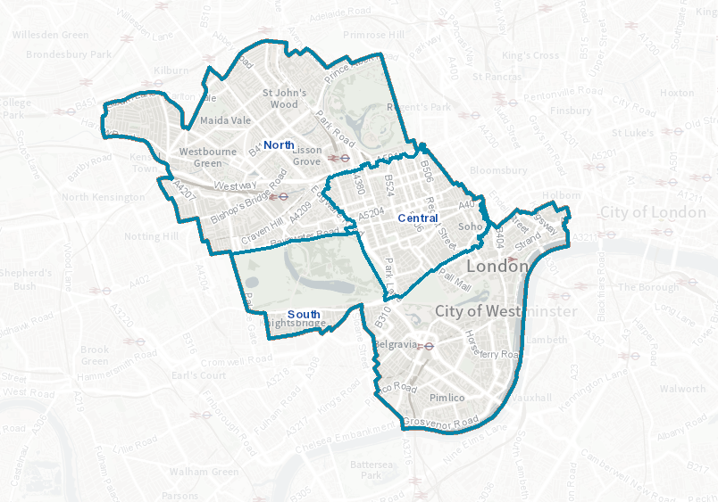
www.sli.do 3865521

Slide 15
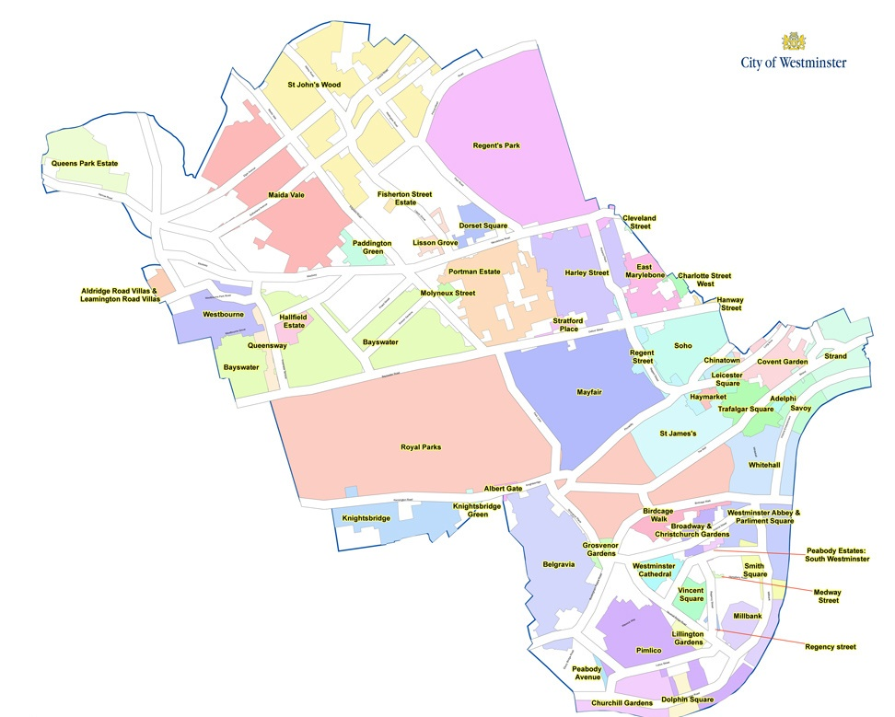
www.sli.do 3865521
Over 11,000 Listed Buildings
55 Conservation Areas
Listed Building:
A building officially recognised for its historic or
architectural significance.
Protected by law against unauthorised alterations.
Classified into grades (I, II*, II) based on importance.
Conservation Area:
A zone noted for its special architectural or historic interest.
Aimed at preserving or enhancing the area's
character or appearance.
Stricter planning rules to manage changes in the area.

Slide 16
Policies and Plans
www.sli.do 3865521

Slide 17
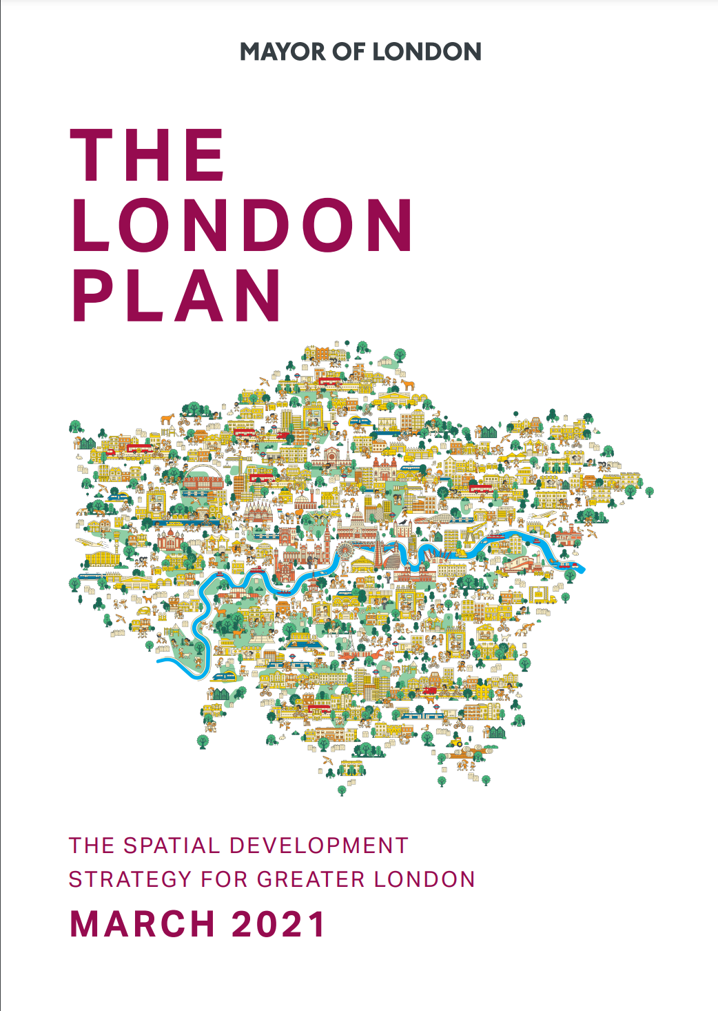

Local Policy
“Climate change is changing the way we do things. Design will prioritise sustainable construction materials, with energy-efficiency on an equal footing as aesthetic appeal…. Specialist attention will be given to retrofitting our historic buildings, so they can take their place in the modern world.”
www.sli.do 3865521
Policy 36 - Energy
A. The council will promote zero carbon development and expects all development to reduce on-site energy demand and maximise the use of low carbon energy sources to minimise the effects of climate change.
Policy 38 – Design Principles
Development will enable the extended lifetime of buildings and spaces and respond to the likely risks and consequences of climate change by incorporating principles of sustainable design…
As new developments are large consumers of resources and materials, the possibility of sensitively refurbishing or retrofitting buildings should also be considered prior to demolition and proposals for substantial demolition and reconstruction should be fully justified on the basis of whole-life carbon impact,
Policy 39 B. Development must optimise the positive role of the historic environment in Westminster’s townscape, economy and sustainability, and will: 1. ensure heritage assets and their settings are conserved and enhanced, in a manner appropriate to their significance; 2. secure the conservation and continued beneficial use of heritage assets through their retention and sensitive adaptation which will avoid harm to their significance, while allowing them to meet changing needs and mitigate and adapt to climate change…
Policy 40 - Townscape and architecture
Development will be sensitively designed, having regard to the prevailing scale, heights, character, building lines and plot widths, materials, architectural quality and degree of uniformity

Slide 18
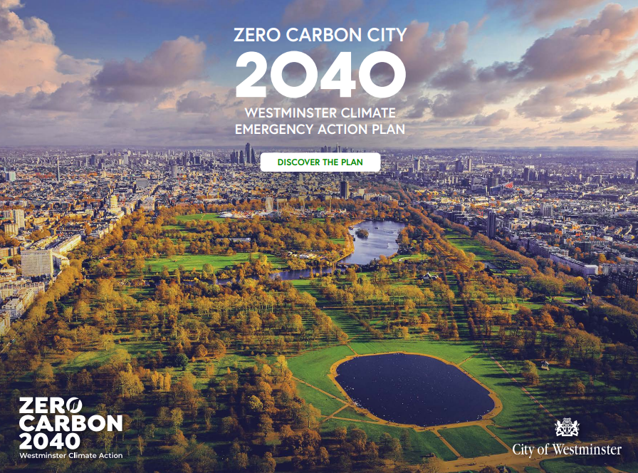
Climate Emergency Action Plan
Sets out sense of urgency and commitment in response to 2019 Declaration
A living document that will need to evolve
Consistent with C40 Cities’ approach to action planning
Benchmarked against other London CAPs
Key principles:
  Credible: evidence based and cost-effective
  Innovative: identifies and utilises new approaches
  Holistic: maximises the delivery of co-benefits – supporting policies and drivers
  Inclusive: fosters a collaborative approach
www.sli.do 3865521
https://www.westminster.gov.uk/tackling-climate-change-westminster/our-climate-action-plan

Slide 19





Emissions Priorities
Efficient Buildings |  | Clean & Affordable Energy |  | Sustainable Travel & Transport |  | Reduced Consumption & Waste |  | Green & Resilient City
Improving building efficiency & deliver energy cost savings |  | Increase the availability, affordability and use of low and zero carbon energy |  | Cut transport-based sources of emissions and air pollution |  | Reduce waste, increase recycling and promote sustainable consumption |  | Enhance the natural environment and ensure the city is resilient to climate change impacts
www.sli.do 3865521
Notes:
Further Notes for Reference
Buildings
1: Retrofitting
2: New developments
3: Residents and businesses cut energy use
4: Organisations take ambitious action to cut CO2
Challenges: historic env 11,000 listed buildings, 56 conservation areas, 121k domestic households – 43% PRS)
Energy
1: Opps for local generation and distribution
2: Support residents, homeowners etc to use low carbon energy
Challenges: 0.03% of Westminster elec demand met by in-borough renewables; sufficiency of elec grid capacity to allow transition to electrical heating, energy costs/costs of living
Reduced waste and consumption
1: Adopt sustainable purchasing practices
2: Step change in recycling
3: Embed circular economy principles
Challenges: how maintain current levels of waste collection whilst seeking to increase recycling rates, how tackle wider impacts of our consumption decisions
Sustainable Travel & Transport
1: Cut vehicle trips and promote active travel
2: Accelerate transition to EVs
3: Consolidate and streanline FSD
4: Reduce travel emissions outside of the city
Challenges: lack of clarity on prioritisation of transport modes
Green & Resilient
1: Protect and enhance existing green space
2: Adapt to future climate impacts
Challenge: much more focus on climate activity is on cutting emissions rather than preparing for climate impacts

Slide 20
Retrofitting Resources and Initiatives
www.sli.do 3865521

Slide 21
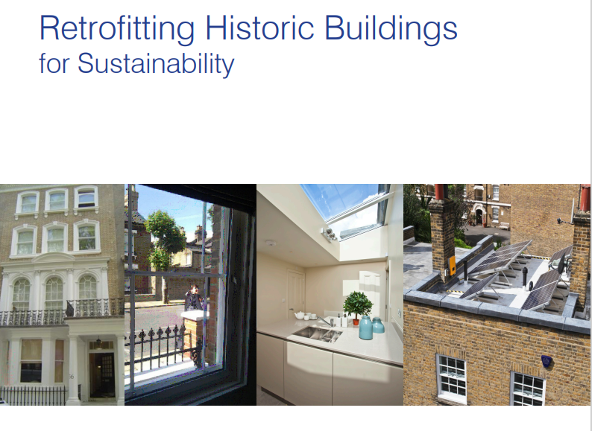
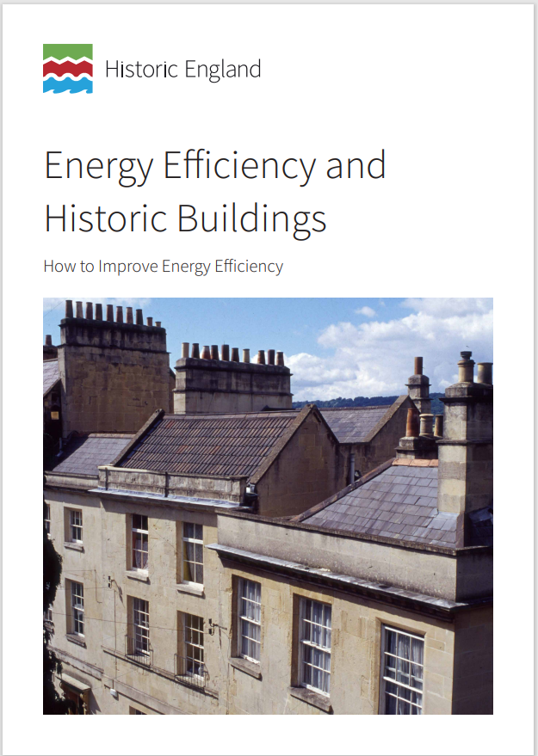
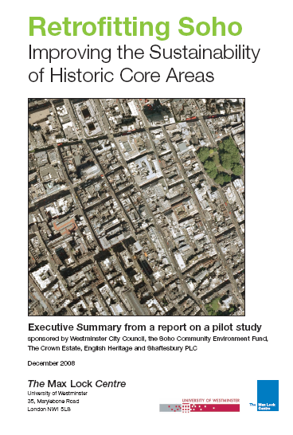
Guidance
www.sli.do 3865521
Retrofitting historic buildings | Westminster City Council

Slide 22

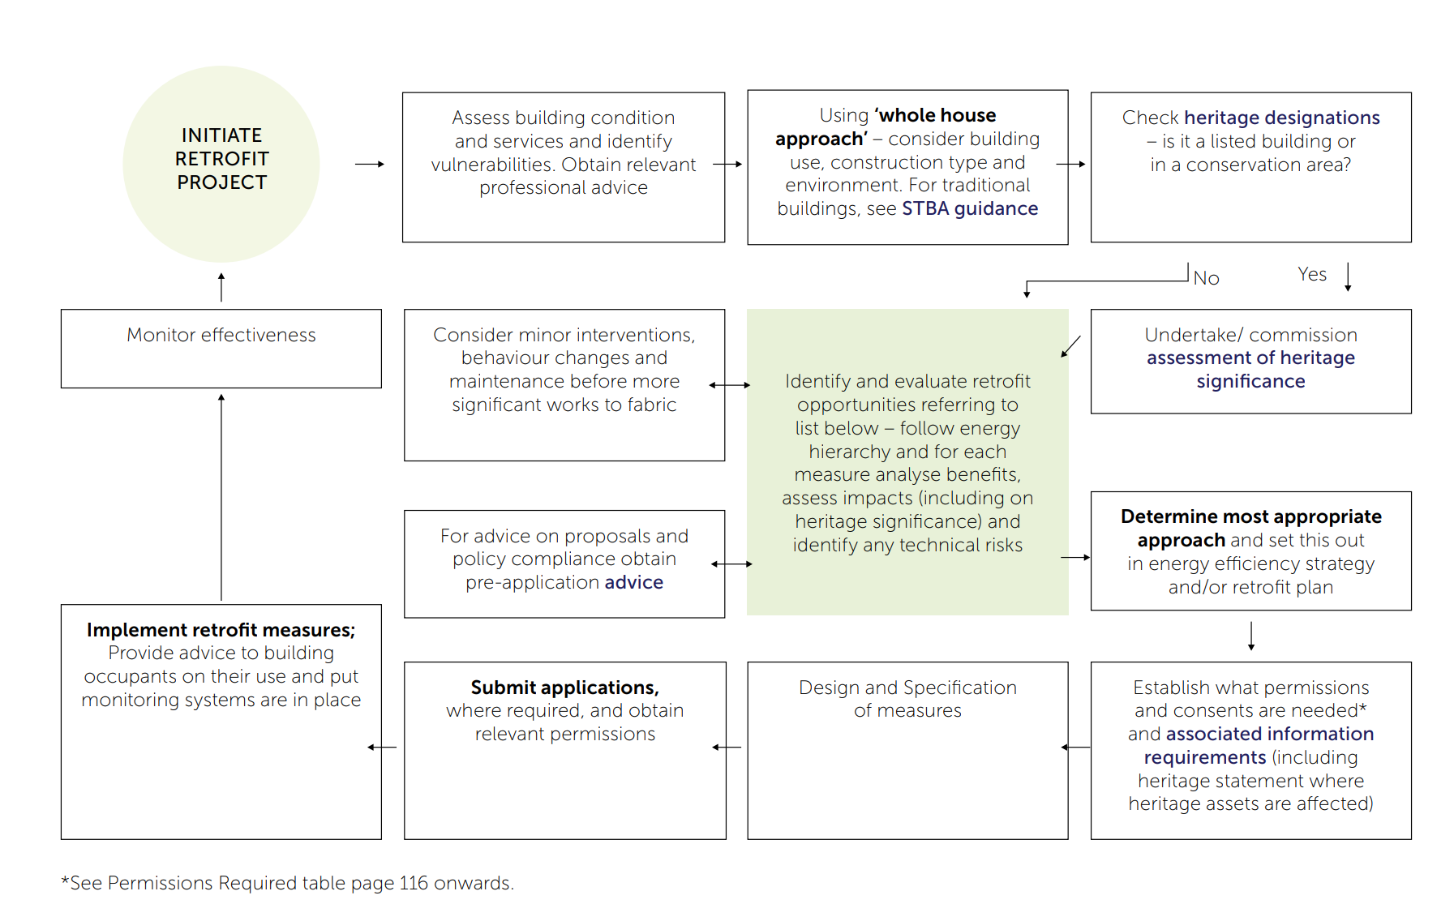

www.sli.do 3865521

Slide 23
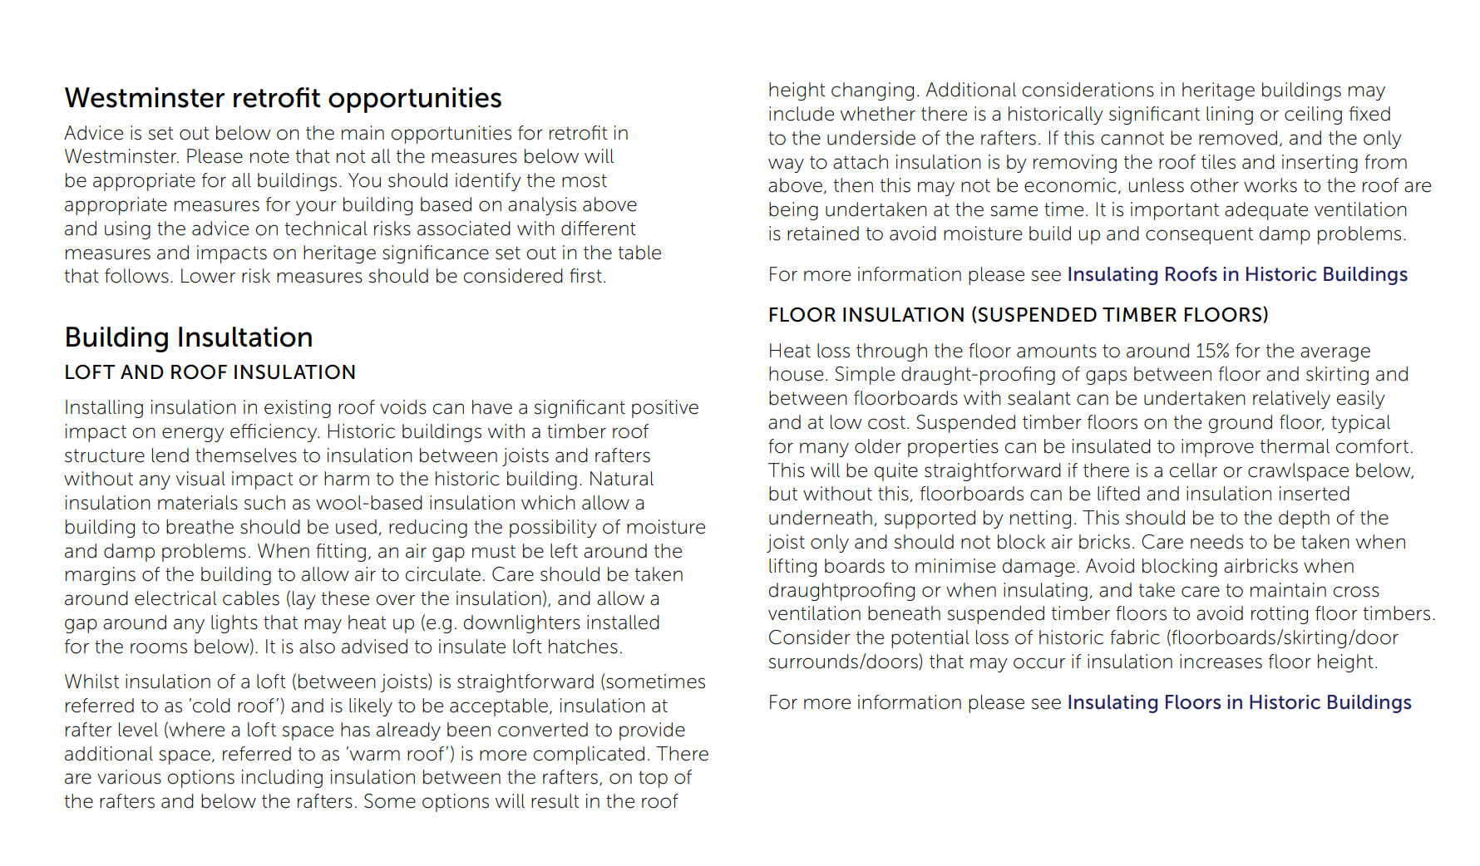
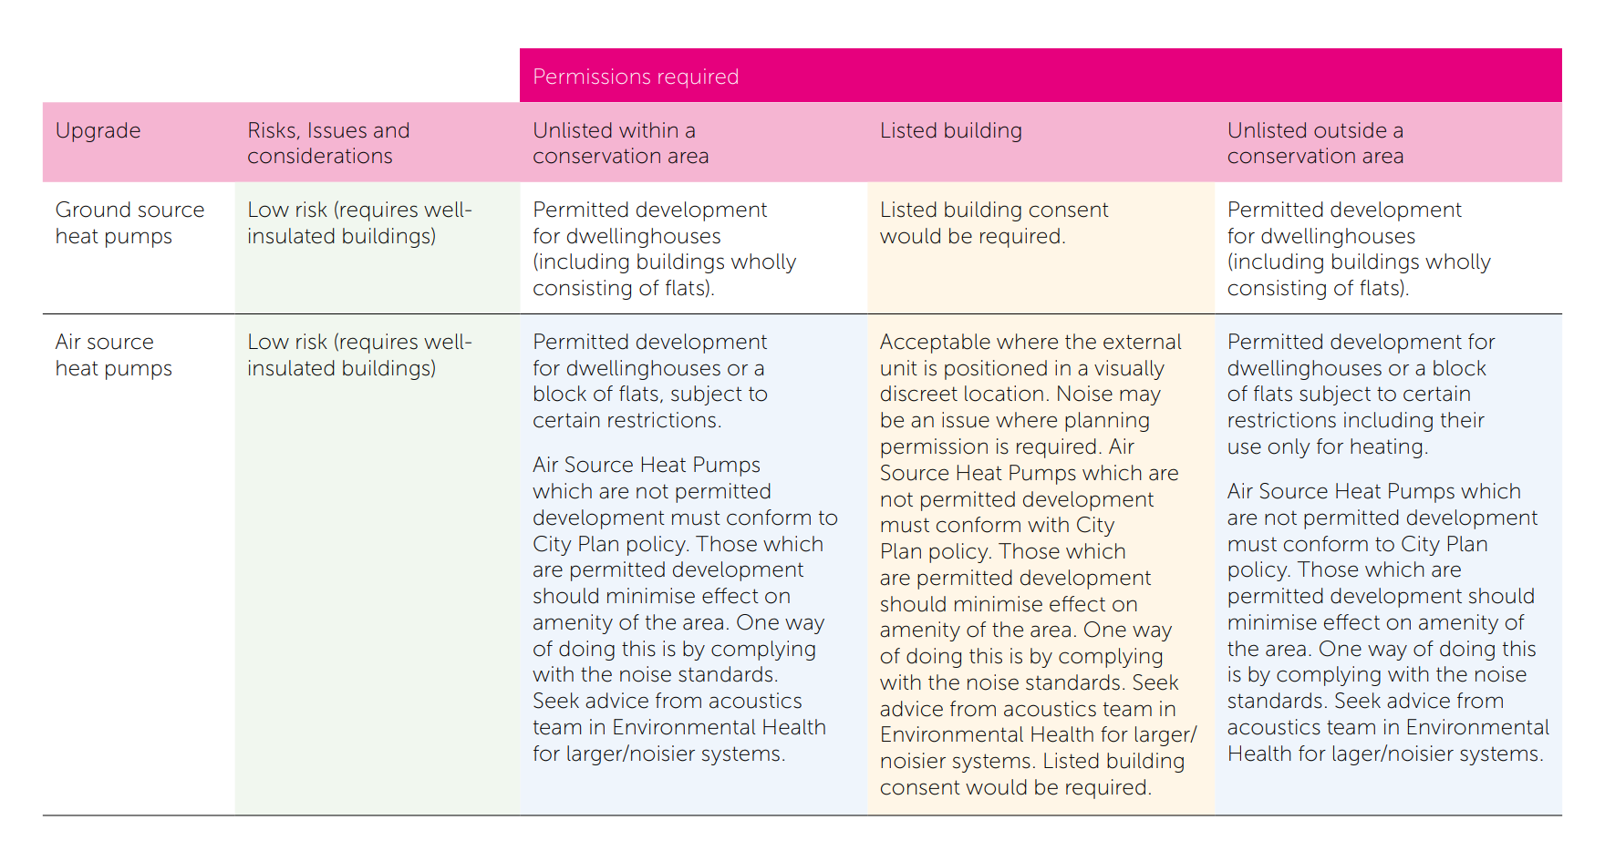
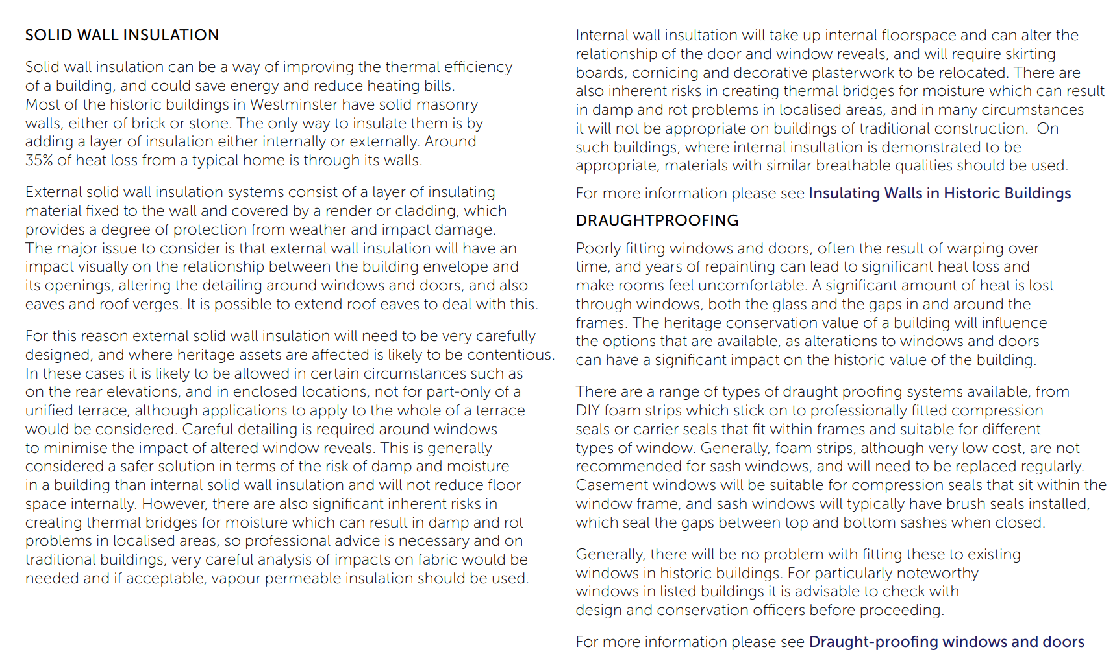
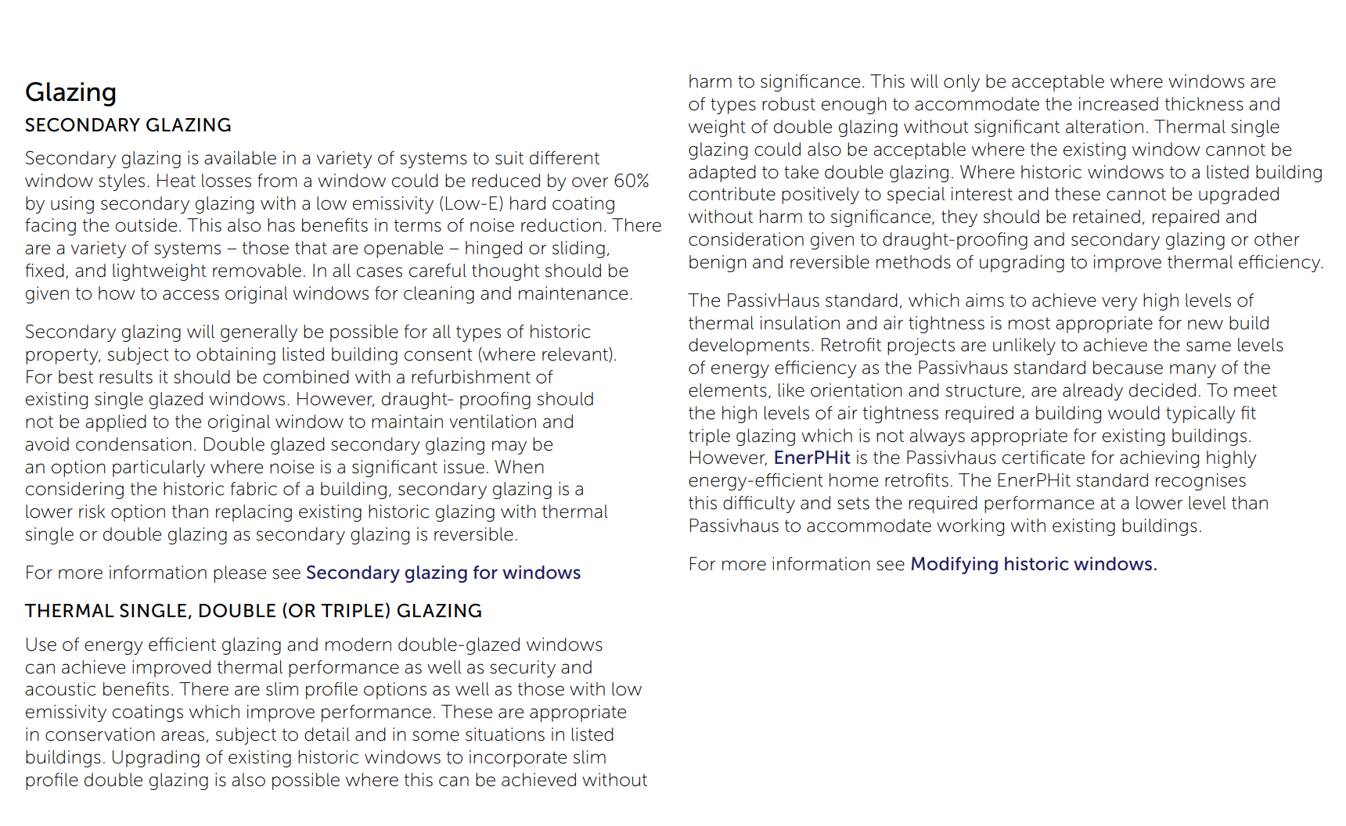
www.sli.do 3865521

Slide 24
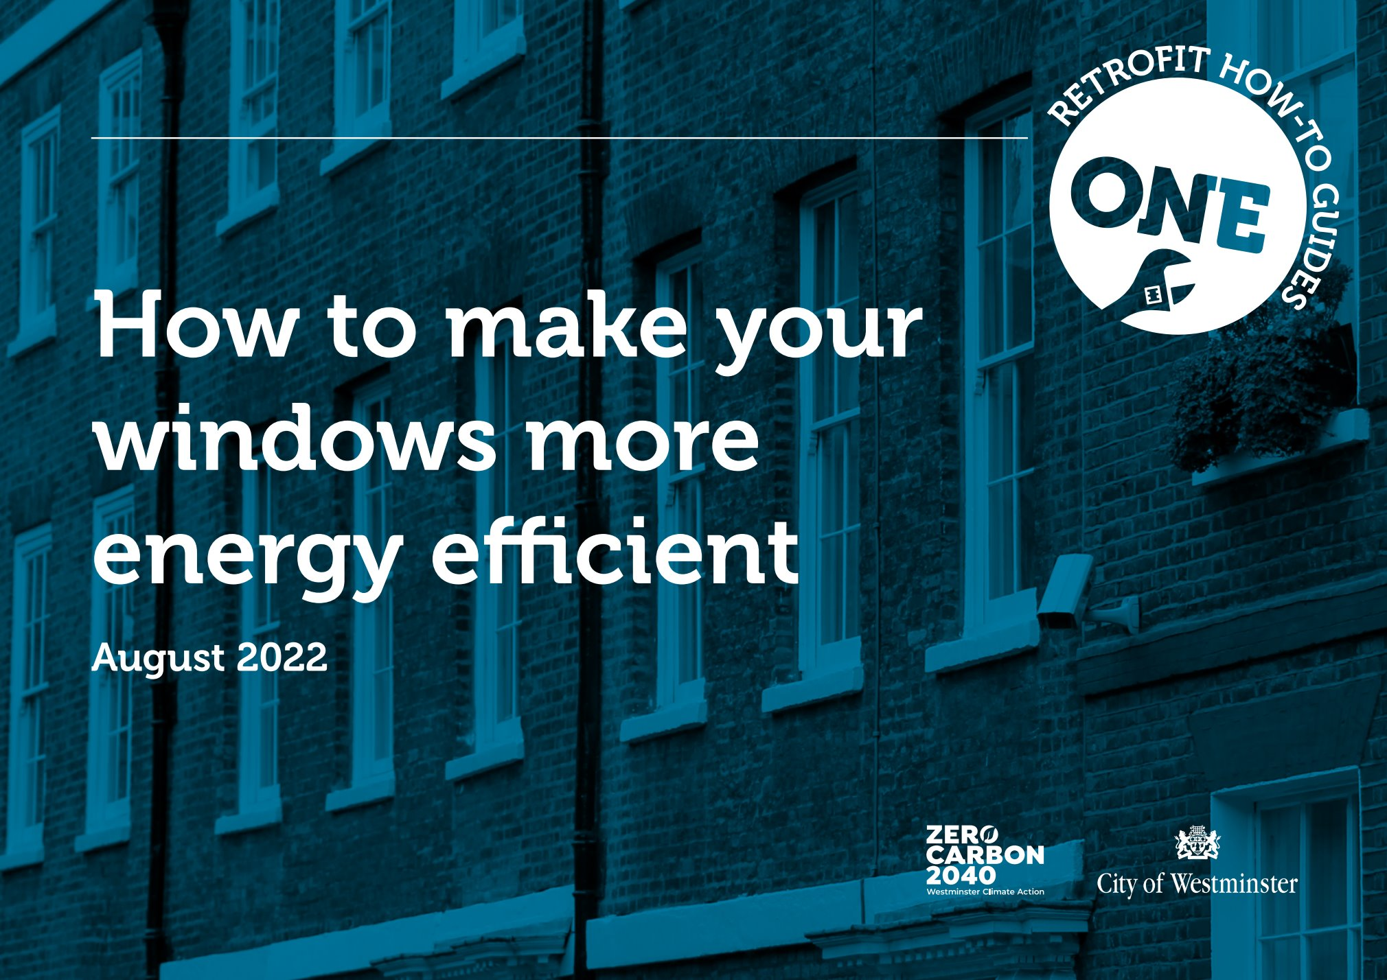


How-to Retrofit Guides
www.sli.do 3865521

Slide 25

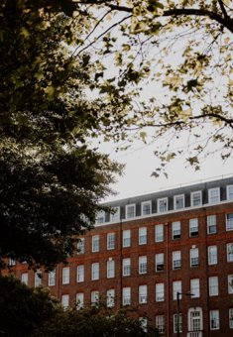
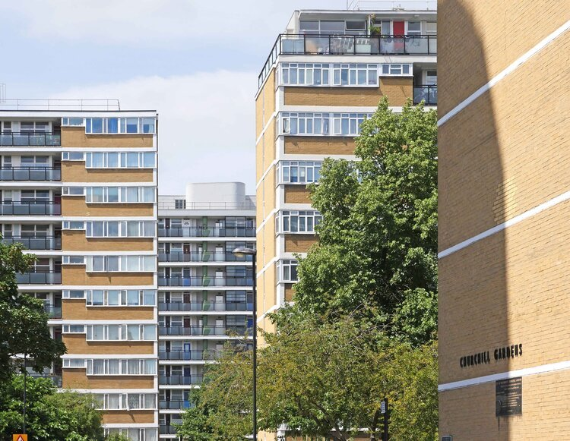
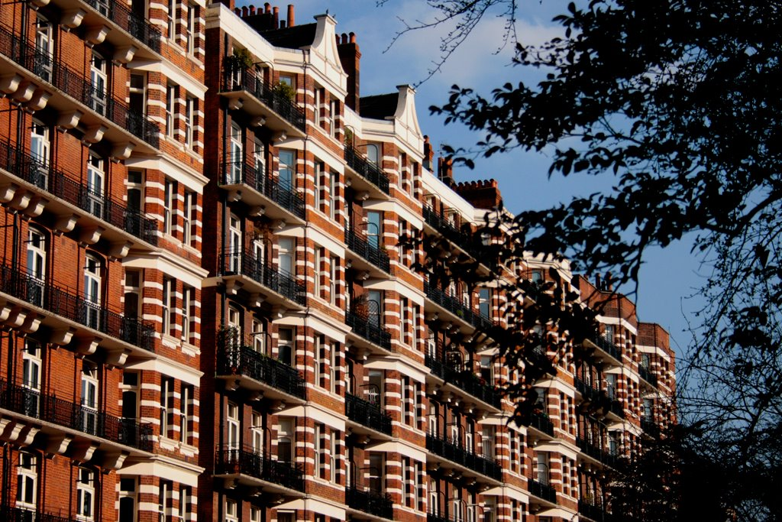
Retrofit Taskforce
86% of Westminster’s emissions are produced from energy used in our homes, hospitals, offices and other buildings.
These buildings include 11,000 listed buildings, in 56 conservation areas covering 78% of the city, the highest number of heritage buildings of any local authority in the UK.
www.sli.do 3865521

Slide 26
Started Activities
Preparing a draft Heritage Partnership Agreement (HPA) with one of the Great Estates which will include retrofit measures;
Initial discussion has been had with Historic England about the potential use of Local Listed Building Consent Orders (LLBCOs) for retrofit measures;
Early discussion with colleagues in Housing about the use of an LLBCO or HPA to enable retrofit of one of Council’s housing estates;
Aim to investigate the potential use of Local Development Orders for replacement double-glazed windows;
Working with policy colleagues on retrofit policy
www.sli.do 3865521

Slide 27
Small Businesses and Community Engagement in Planning
www.sli.do 3865521
We want to hear from you
Common Challenges in Planning for Energy Efficiency
Identifying Key Concerns/Barriers
Go to www.sli.do and enter the code 3865521 to submit your comments/questions or use the QR code on this slide
Contact details to send your comments: planningreception@westminster.gov.uk
(please quote "Sustainable Business Practices Workshop")

Slide 28

SUSTAINABLE CITY CHARTER OVERVIEW
Key Information
A free business-led initiative supported by the Westminster Property Association and Westminster City Council​
Has been running for 1 year and has over 50 signatories so far, which collectively account for 14% of Westminster’s total non-domestic floorspace
Signatories become part of a charter network that benefits from exclusive activities and knowledge-sharing sessions
Governed by a Steering Group and Technical Working Group, made up of early signatories
Aims of the charter
To grow an organizational network that actively shares best practice and sustainability support
To better understand the sustainability challenges facing businesses and public institutions, and develop tools to support them
To set a common ambition for driving down emissions from existing non-domestic buildings in Westminster (70% of Westminster’s total emissions) and track progress against this
To provide a mechanism for landlord-tenant engagement in Westminster’s complex commercial building landscape
Notes:
Isobel

Slide 29
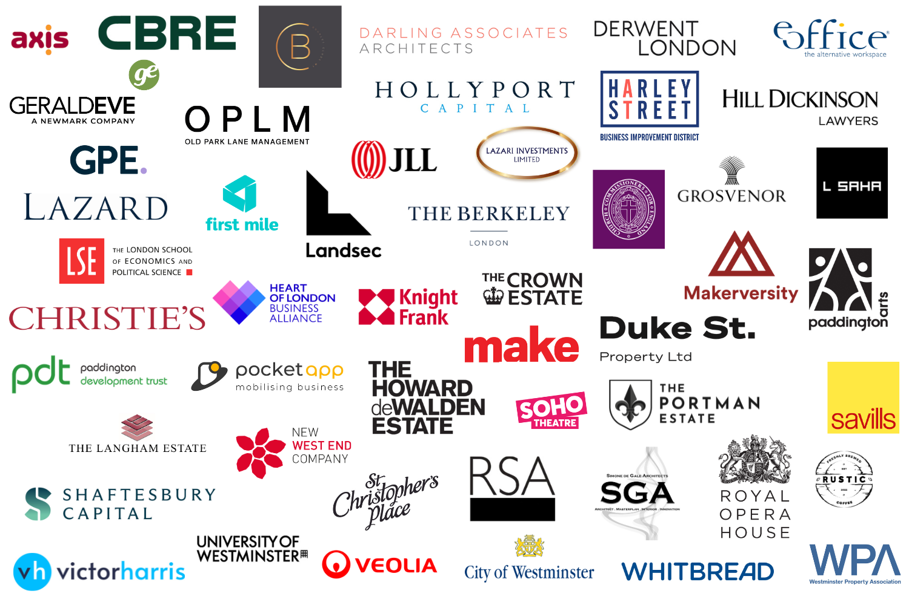
53 SIGNATORIES
Notes:
Isobel

Slide 30

WHY DO BUSINESSES SIGN UP TO THE CHARTER?
​
Demonstrate to staff, customers and clients real commitment to climate action​ at the local level (in Westminster), to complement national pledges such as SBTi
Gain access to the charter network and the exclusive events, tools and information provided through the network
Build up professional contacts and see how other businesses in their sector are tackling similar sustainability and clean energy transition challenges
Have a mechanism with which to engage with other stakeholders within their buildings (landowners, tenants, managers)​
Notes:
Isobel

Slide 31



WHY DO BUSINESSES SIGN UP TO THE CHARTER?
‘The Langham Estate has been making major strides towards our net zero ambitions, and participating in Westminster City Council’s Sustainable City Charter is a public commitment to this work. Being part of the charter is an opportunity to collaborate with other businesses and organisations across the West End in our collective goal towards ensuring a safer and more sustainable city.’
Richard Hillyard, The Langham Estate
“The Charter is a great way to ignite the focus of local businesses and property owners who proactively wish to reach the global sustainability goals over the next couple of decades. Victor Harris is also playing an active role in endorsing sustainability by advising businesses and landlords in relation to their commercial property”
Lloyd Harris, Victor Harris Commercial
‘Climate change is an issue which can only be addressed collectively – both nationally and locally. Therefore, as a property owner in Westminster we have a responsibility to support our stakeholders in climate action at the local level. This is why we signed up to and actively support the Sustainable City Charter’
John Davies, Derwent London
Notes:
Isobel

Slide 32













BENEFITS AND SUPPORT FOR SIGNATORIES
Delivered in 2023
Planned
Two webinars and Q&As, focusing on sustainable procurement and waste/circular economy
A guided site visit and Q&A at The Forge, an ultra-sustainable new build
A series of detailed case studies of actions taken in Westminster against each of the charter commitments
A workshop to contribute to the development of Westminster’s Local Area Energy Plan
Development of a website for the charter with a search function to access guidance on implementing charter commitments
A focused event on culture & climate action hosted at the Royal Opera House
Being a charter signatory to be included as a secondary criteria for allocation of carbon offset funding in updated guidance for 2024
An additional 10% discount on recycling services through Westminster’s Commercial Waste Service
Our first Sustainable City Charter newsletter, with signatory spotlights and links to new publications
Further webinars, site visits and other knowledge sharing events in 2024
‘Climate Essentials for Business’ carbon tracking platform offer for landowners
Surveys & interviews with businesses on their barriers to climate action, to guide future support
Delivery consolidation pilot projects being delivered through the Zero Emissions Group
Notes:
Isobel

Slide 33
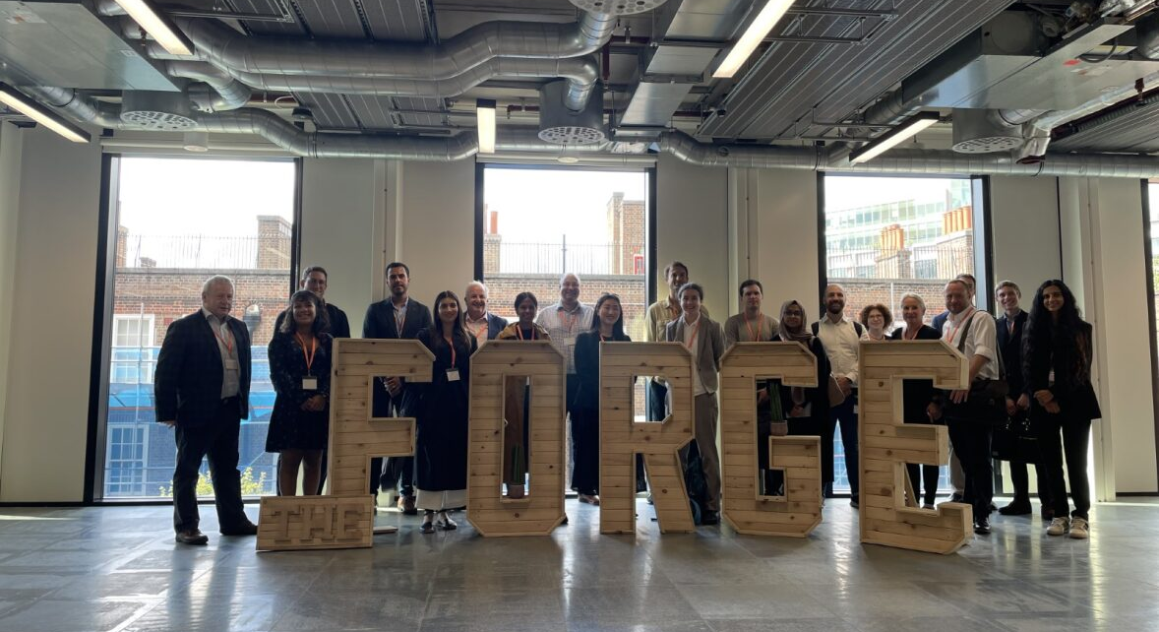

Slide 34

HOW TO SIGN UP
To sign up to the SCC: Submit an application form explaining how you will take action against each of the Charter commitments (below) and provide your total gas and electricity consumption across your buildings in Westminster.
Charter commitments (summary):
  Actively engage with other building stakeholders including through green leases and sharing of environmental data.
  Audit buildings to create action plans to net zero operational emissions by 2040 or earlier.
  Introduce sustainable procurement policies for your buildings
  Review your planned fit-outs and redevelopments to ensure they are in line with your net zero pathway.
  Set up new local consolidation schemes for deliveries to buildings.
  Reduce your fleet size and encourage staff to use low-carbon transport.
  Reduce and recycle building waste
Commit to annual reporting of your energy consumption and a short update on your progress in implementing the Charter.
Note: Any information provided in applications & annual updates may be shared with the Steering Group and Technical Working Group for the purposes of monitoring the charter, but is not made public without prior consent
Notes:
Isobel

Slide 35
Sustainable business practices –
University of Westminster
Virginia Cheung, Energy Officer
Morgan Lirette, Sustainable Development Advisor
24 January 2024

Slide 36

… a shared blueprint for peace and prosperity for people and the planet, now and into the future …

Slide 37


Target 1.1 - By 2030, eradicate extreme poverty for all people everywhere, currently measured as people living on less than $1.25 a day
Indicator 1.1.1 - Proportion of the population living below the international poverty line by sex, age, employment status and geographical location (urban/rural)

Slide 38
Our sustainable development journey
SDG Working Group established,
SDG buy-in from University Executive Board,
initial priority SDGs identified
2019
SDG 4.7 Education for Sustainable Development prioritised
2023
2015
Agenda 2030 and SDGs adopted by UN Member States
2018
New VC,
Corporate Social Responsibility strategy review
2020
SDG Action Plan developed
2022
Being Westminster 2022-29 published with ‘sustainable development’ priority, Sustainable Development Advisor hired

Slide 39
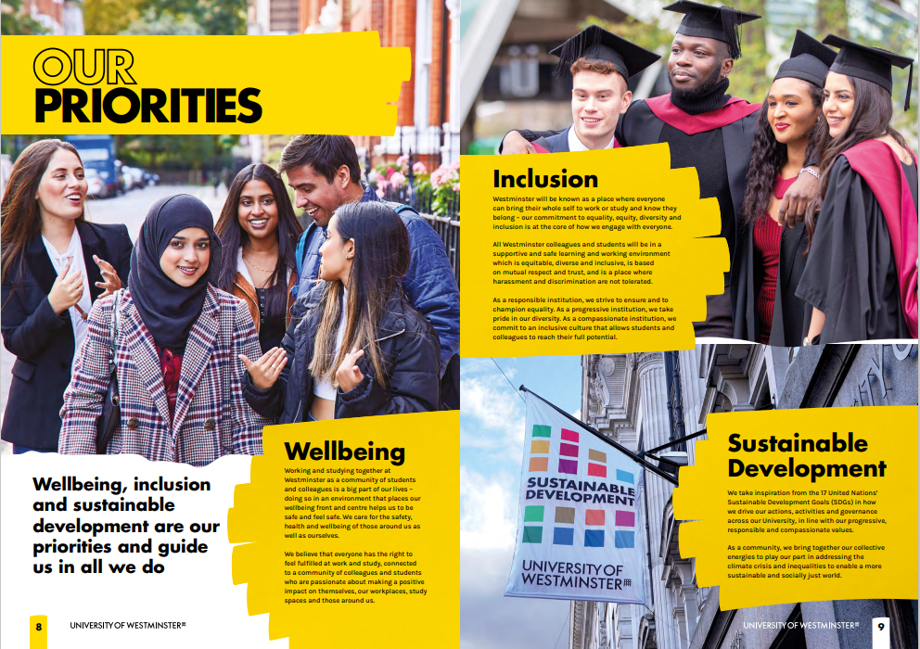
Being Westminster 2022-29

Slide 40

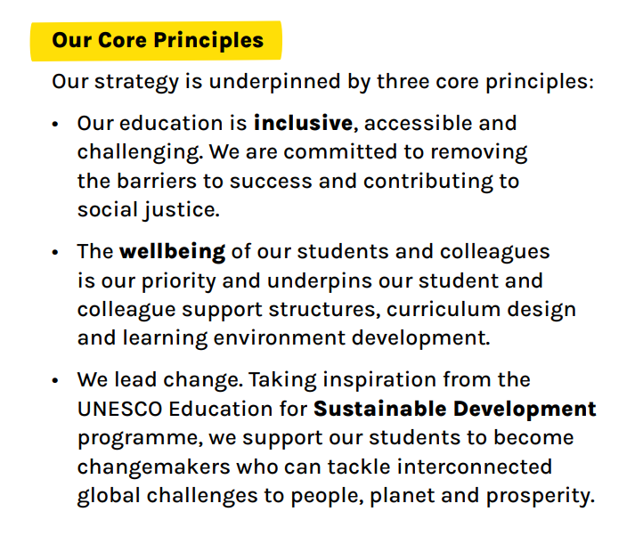
Education Strategy 2023-2029

Slide 41
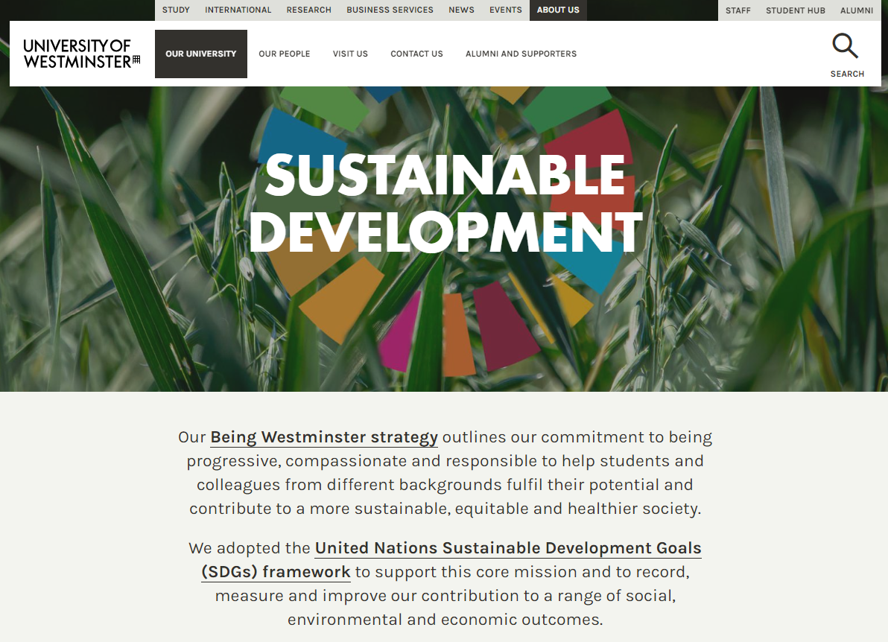
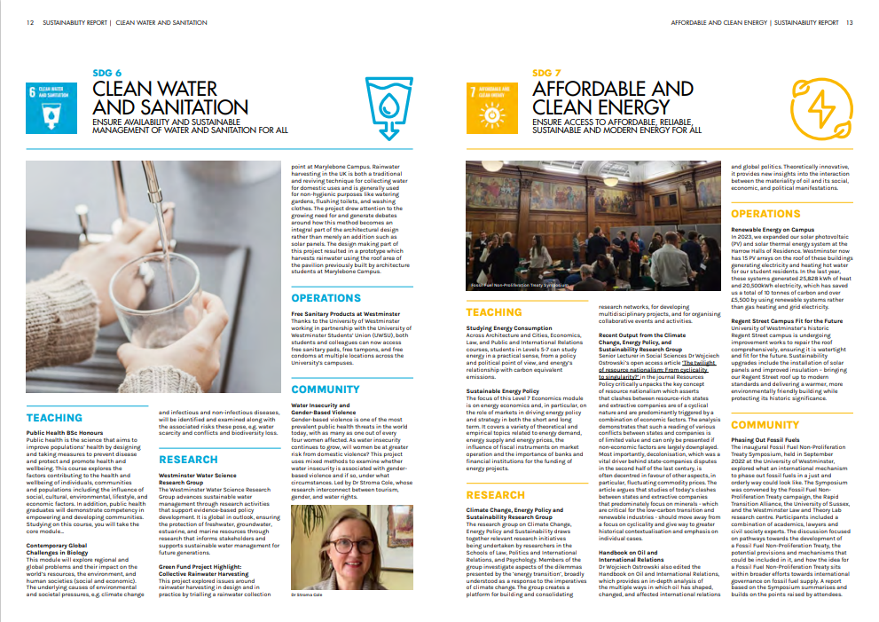


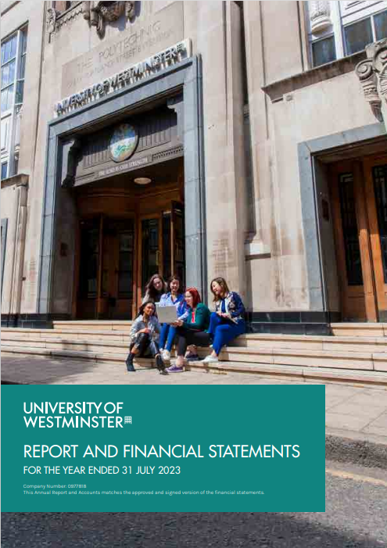
Sustainable Development | University of Westminster, London

Slide 42

University of Westminster- Carbon Management
24 January 2024– Virginia Cheung

Slide 43








Working towards UoW’s environmental impacts
Water
Sustainable Travel
Carbon
Energy
Biodiversity
Supply chain management
Waste and
Recycling
Built Environment

Slide 44
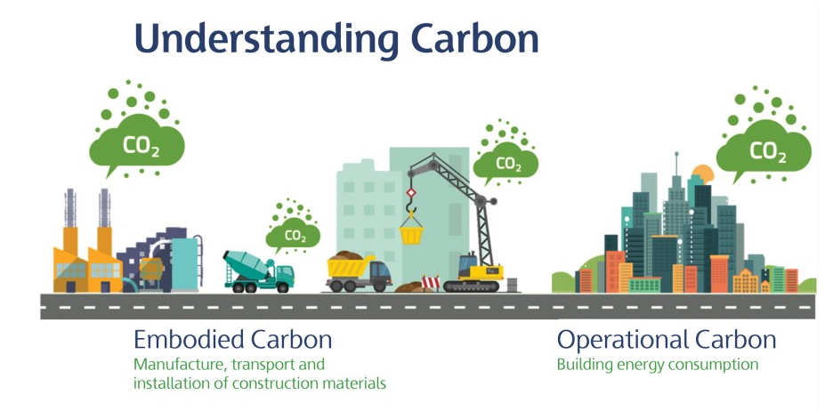

Slide 45
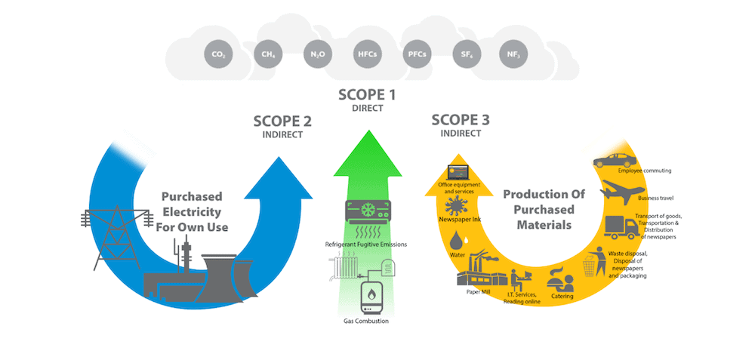
Understanding Carbon

Slide 46

Our carbon targets
Carbon net-zero for Scope 1 and 2 carbon emissions by 2035
Reduce Scope 3 carbon emissions by 50% by 2035 against 2019/20 average baseline data.
Carbon net-zero for direct and indirect (Scope 1, 2, and 3) carbon emissions by 2050.

Slide 47

Carbon Performance
Year | Target (t/co2) | Performance (t/co2) | Notes
2005/2006 |  | 14350 | Benchmark emission
2022/2023 |  | 5900

Slide 48
New Target set - Net zero by 2035

Slide 49

Decarbonation Plans
Heat Decarbonisation is the main challenge
New Heating Decarbonisation plans
Key buildings for electrification (electric heating, ASHP)
New builds all electric heating

Slide 50
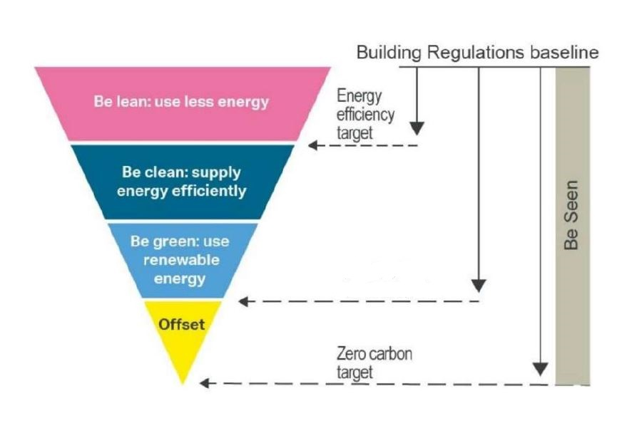
UoW approach to decarbonisation
Measure
Be Lean, Be Clean, Be Green
Offset

Slide 51
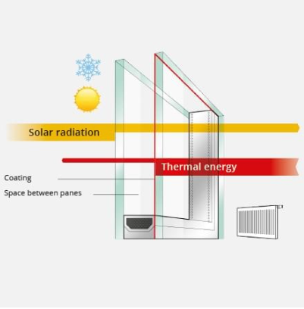
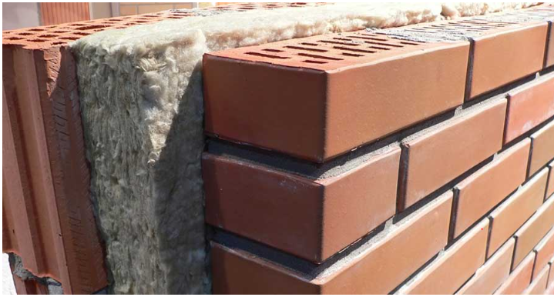
Be Lean
Use less energy
manage demand during operations by fabric and serving improvements
Insulations
Glazing

Slide 52

Be Clean
Utilizing local energy resources
Supply Energy efficiently and cleanly
Energy efficiency projects

Slide 53
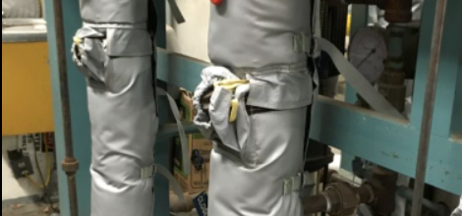
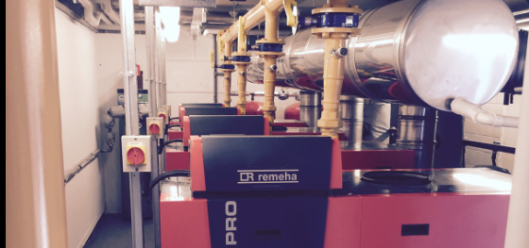
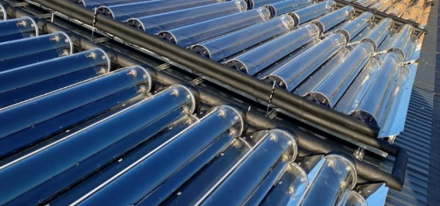
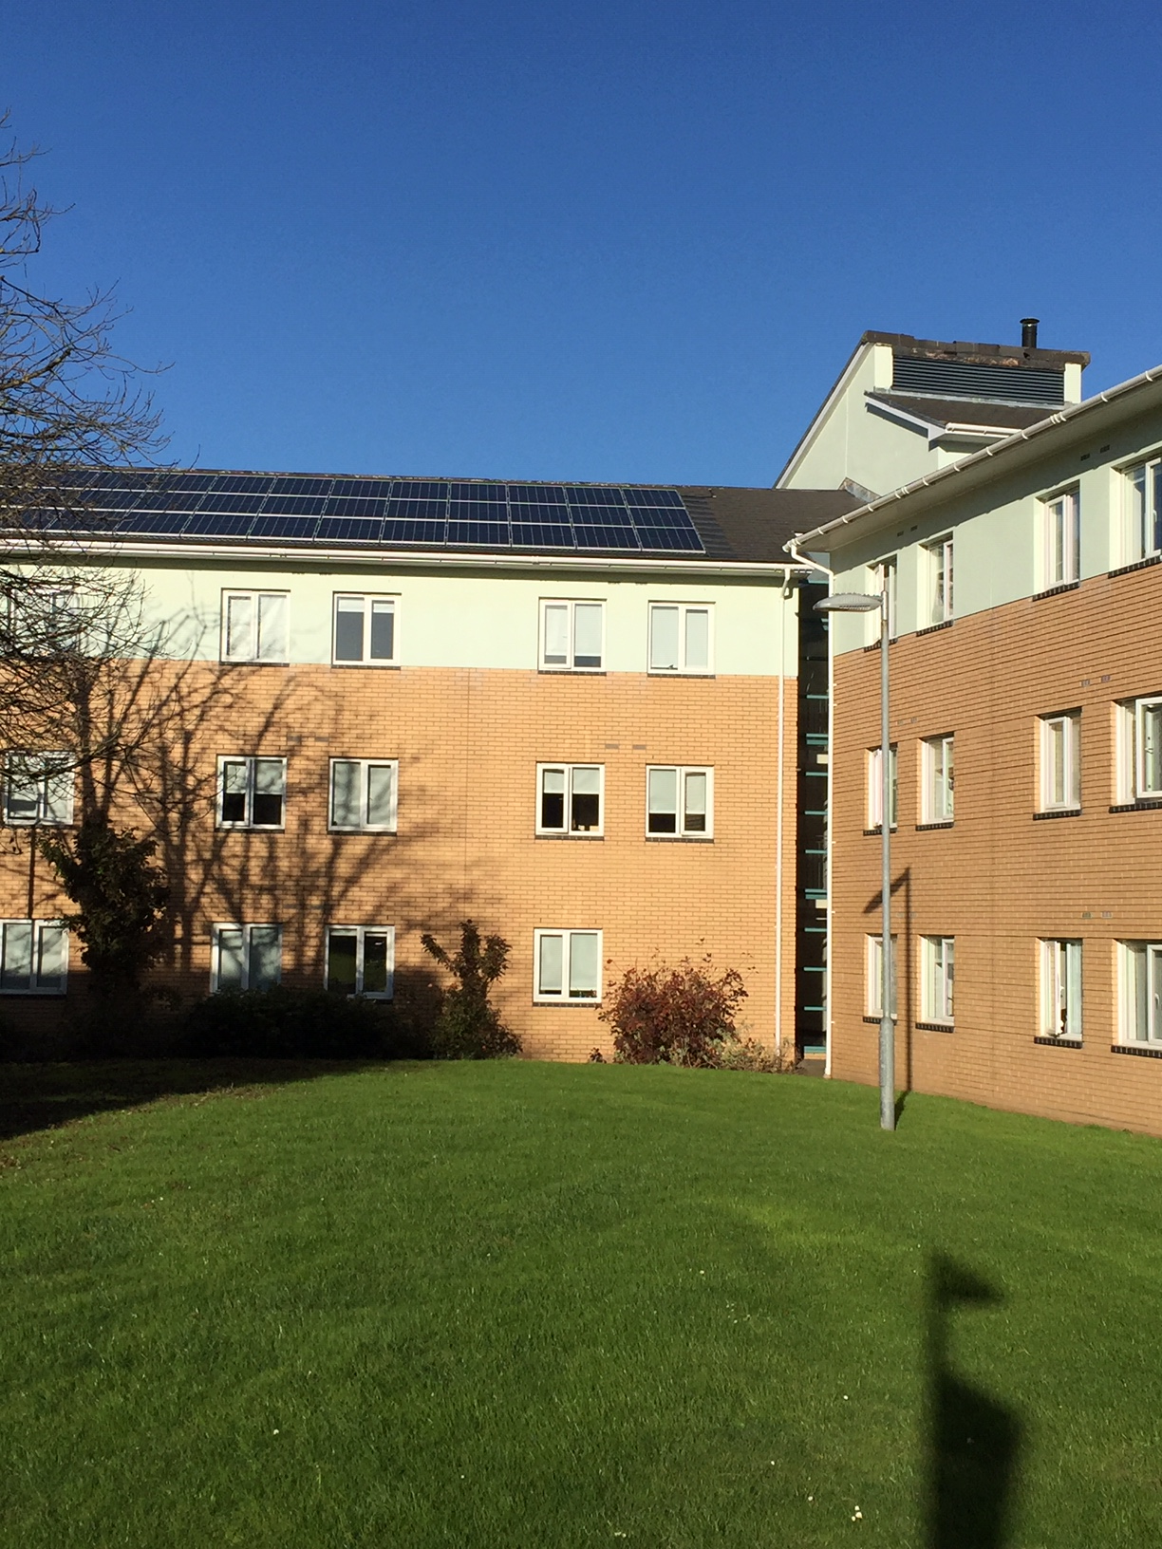
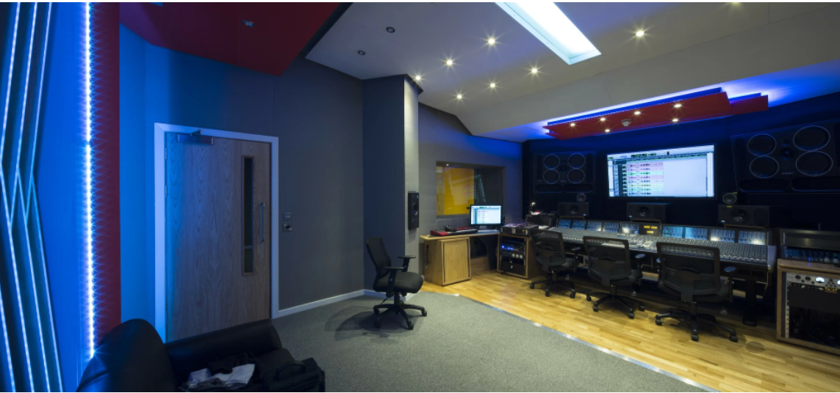
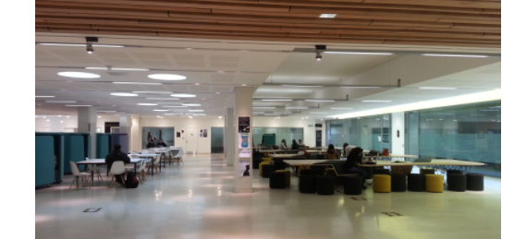
Some Energy Efficiency Measures
Pipework insulations
Boilers upgrade
Solar Thermal
Solar Panels
LED lights upgrade
Zoning with controls

Slide 54
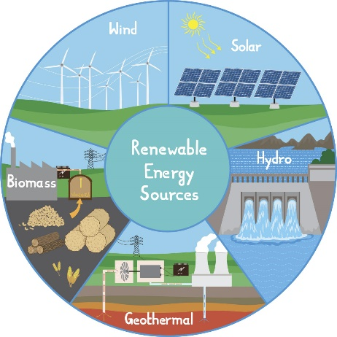
Be Green
Solar panels and thermal to generate energy on site
Buy 100% renewable electricity
10% of the electricity are powered by solar PV at Harrow halls
300,790 kWh per year
Maximize opportunities for renewable energy on-site

Slide 55
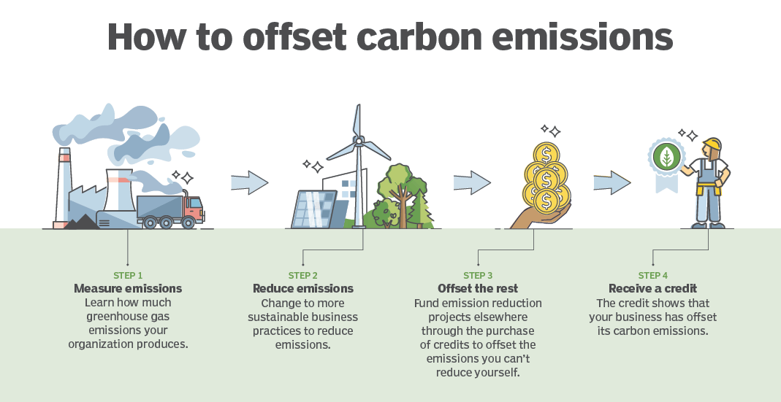
Last resort- Carbon offsetting
Purchase carbon credit to reduce carbon we can’t offset

